Slide 1
ML Study Jams
Session 1
Sarthak Harne
Naitiksinh Solanki

Slide 2
What is Machine Learning?
More importantly - What do you think ML is?
Think of how a human brain learns

Slide 3
The next logical question is…
How do we nurture our ML Model?
The same way you would do when you want a child to become a good person.

Slide 4
Pay attention to your Data!
Lot of the work is done if you have good data!
We need to clean and process our data before feeding it to our model.

Slide 5
Time for a demo!
Let us check out Google Colab

Slide 6
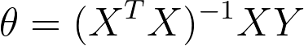
What exactly is Linear Regression?
The short answer is fitting a line to your given data
The long answer is:

Slide 7
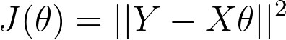
The Idea of Loss Function
The Loss Function is the drive force of any Model

Slide 8
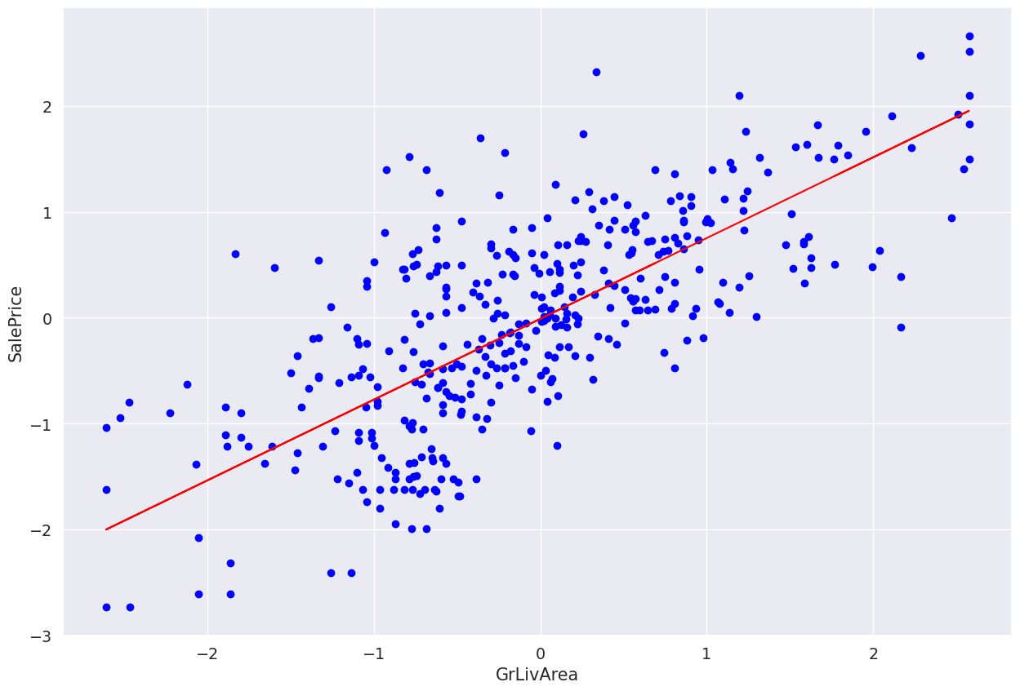
How did that happen?
Think of it like minimising the vertical distance

Slide 9
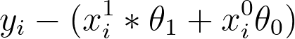
Obtaining the Loss Function: Step 1
We look at the vertical distances at each value of x

Slide 10
A Little about our Convention
The variables in the i^{th} row are denoted by: x_{i} and y_{i}
The j^{th} feature of the i^{th} row is denoted by: x_{i}^{(j)}

Slide 11
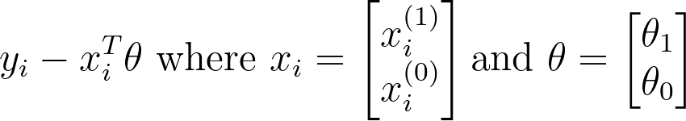
Making it easier to read!
Dealing with vectors and matrices have many benefits!
Can be written as:

Slide 12
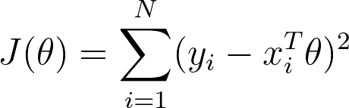
Obtaining the Loss Function: Step 2
Now we need to sum the square of the vertical distances

Slide 13
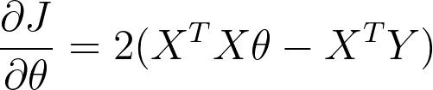
The Gradient
We will differentiate J wrt Θ

Slide 14
Closed Form Solution
One Step Solution for our problem

Slide 15
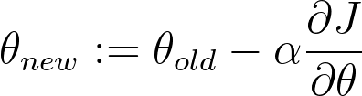
One more way - Gradient Descent!
This is what ‘Training a Model’ usually looks like

Slide 16
Thanks for attending!
GDSC IIIT Bangalore

